Slide 1
Statistics for the Social Sciences
Section 1.3: Using Spreadsheets
Prepared by Adam J. McKee
Notes:
This Revision: 10/12/2015

Slide 2
What is a Spreadsheet?
Spreadsheets are computer programs that store and allow the user to manipulate data.
What makes spreadsheets different from other types of data storage programs is that they are in tabular form.
That is, they organize the data into rows (going across) and columns (going up and down).

Slide 3
Why We Care
Spreadsheets can store many different types of data, but, in statistics, we are mostly interested in the ability to store and manipulate numeric data.
One of the most useful features of spreadsheets is that they allow the user to perform calculations rapidly.
They also allow the user to perform very complex calculations involving multiple steps.
What this means for the statistics student and researcher is that spreadsheets make complicated statistical calculations as simple as specifying what columns and rows will be involved in the calculations.

Slide 4
Generic Software
Microsoft's Excel spreadsheet program is probably the best known and best documented software of its type in the world.
It is because of this near universal availability that this text provides instructions for computing basic statistics with this particular software.
Other spreadsheets (such as Google Sheets) are available, but the process will be very similar.

Slide 5
Specialized Software
There are also several prominent statistical packages that are designed exclusively for the statistical analysis of data.
These specialized programs really shine when a researcher is using complex multivariate methods coupled with very large datasets.
For learning basic statistics, the more common spreadsheet programs will work just fine.

Slide 6
About the Data Analysis ToolPak
Many of the statistical methods discussed in this book can be computed using Microsoft’s powerful and popular spreadsheet program Excel.
The Data Analysis ToolPak is not installed with the standard Excel setup.
Look in the Tools menu: If you do not have a Data Analysis item, you will need to install the Data Analysis tools.
Search Help for "Data Analysis Tools" for instructions.

Slide 7
How Spreadsheets Work
To make statistical computations in Excel, you must first learn how to use functions.
A function is a formula that is predefined within Excel to accomplish a specific task.
Remember that in a table of numbers such as a spreadsheet, the lines of numbers going up and down are called columns, and the lines of numbers going side to side are called rows.

Slide 8
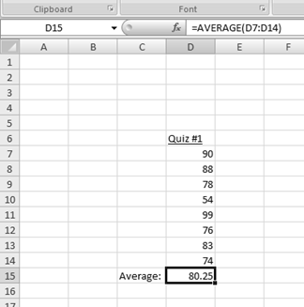
Average Example
Let us say we want to do something simple like compute the average for a quiz taken by our statistics class. We can set up an Excel sheet to do the job as follows:

Slide 9
About Functions
Note that all of the quiz scores are placed in a column.
The value 80.25 is the average (mean).
The value was not typed in, however: Excel put it there.
What was typed in was the function.
Functions may look a little complicated at first, but they are very easy to use once you understand the anatomy.

Slide 10
Entering a Function
In the function bar at the top of the table we see the syntax: =AVERAGE(D7:D14).
All functions in Excel begin with an equal sign.
That is how Excel knows it is a function and not just text or numbers.
We could have placed the function in any cell, but it makes sense to put it at the end of the column.

Slide 11
Dissecting a Function
AVERAGE is the name of the predefined function that we are using to compute the mean.
The (D7:D14) tells Excel to compute the average of the range of cells D7 through D14.

Slide 12
Using Automatic Features
To insert a function automatically, first click on the cell where you want to place the function.
Then, under the formulas tab, click insert function.
This will open the insert function dialog box.
Most of the functions we will be using will be found under the “statistical” category.

